Slide 1
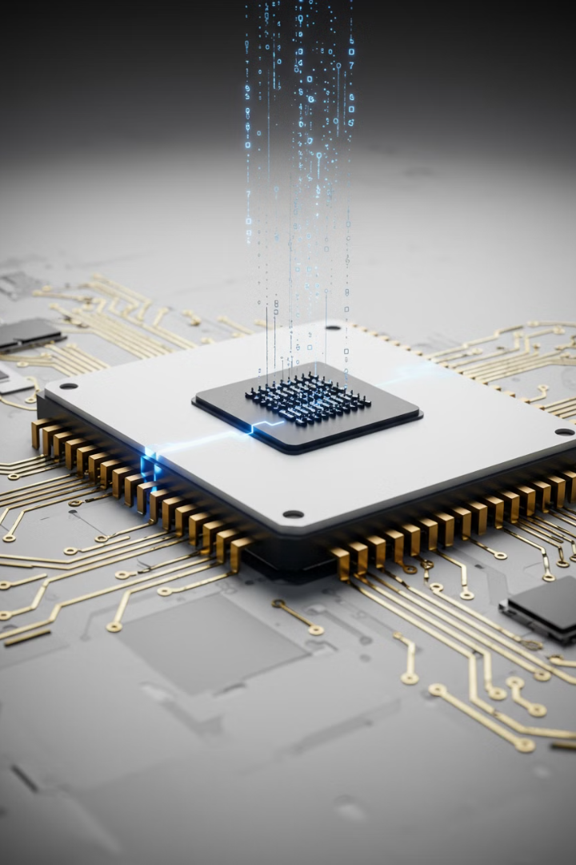

Graphics Processing Unit (GPU)
A Graphics Processing Unit (GPU) is a special type of computer chip designed to handle graphics and visual tasks very quickly. It's like a super helper for your computer, especially when it comes to showing images, videos, and games on your screen.
by Ram N Java

Slide 2
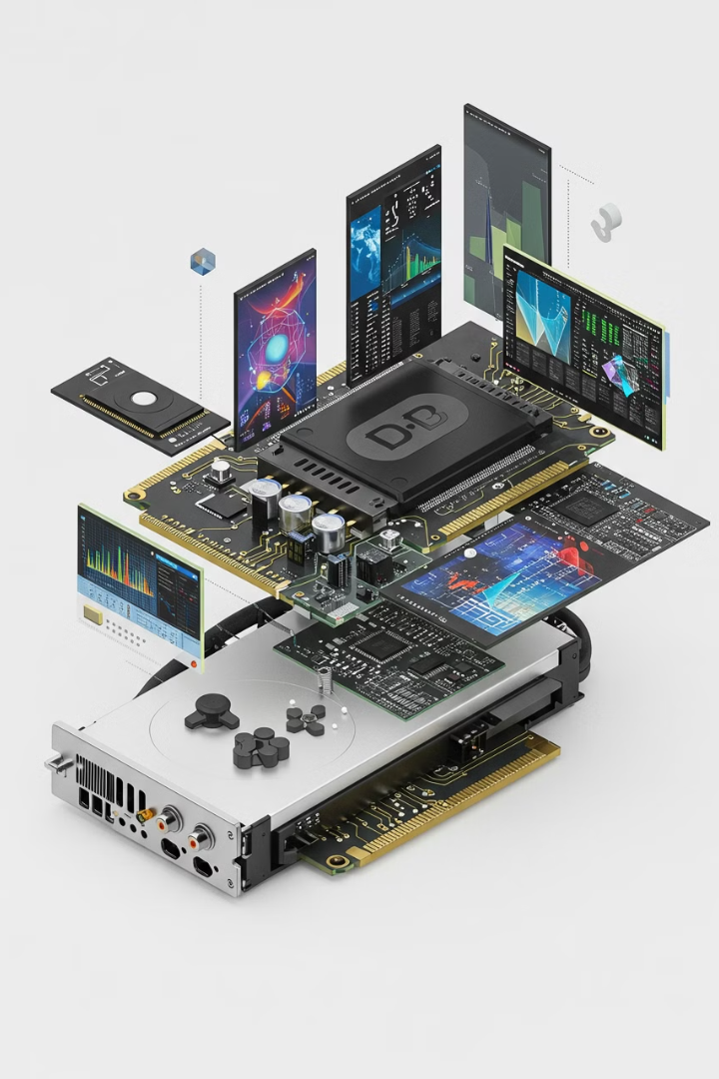
What Does a GPU Do?
1
Handles Graphics
2
Speeds Up Tasks
The main job of a GPU is to take data from the computer and turn it into pictures, videos, or animations that you can see on your screen.
A GPU is very good at doing many small tasks at the same time. This is called parallel processing.
Example: It can calculate the color of millions of pixels on your screen all at once.
Example: When you play a game, the GPU creates the 3D worlds, characters, and effects you see.
3
Helps with Non-Graphics Work
GPUs are also used for tasks that need a lot of calculations, like machine learning, scientific research, and video editing.

Slide 3

How is a GPU Different from a CPU?
CPU (Central Processing Unit)
GPU
The CPU is the brain of the computer. It handles general tasks like running programs, opening files, and managing the system.
The GPU is like a team of workers. It's great at doing many small tasks at the same time.
It's specialized for visual tasks and heavy calculations.
It's good at doing one thing at a time very quickly.

Slide 4
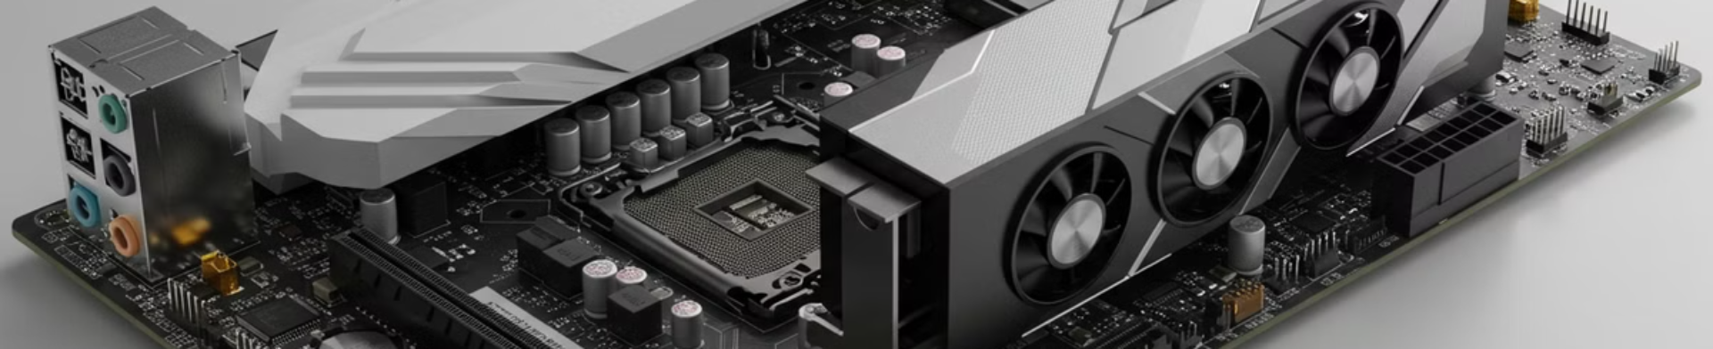
Where is the GPU Located?
Integrated GPU
Dedicated GPU
Some GPUs are built into the same chip as the CPU. These are called integrated GPUs.
A dedicated GPU is a separate chip on its own circuit board. It's much more powerful and used for gaming, 3D design, and video editing.
They are less powerful but good for everyday tasks like watching videos or browsing the web.
Example: NVIDIA and AMD make popular dedicated GPUs.

Slide 5
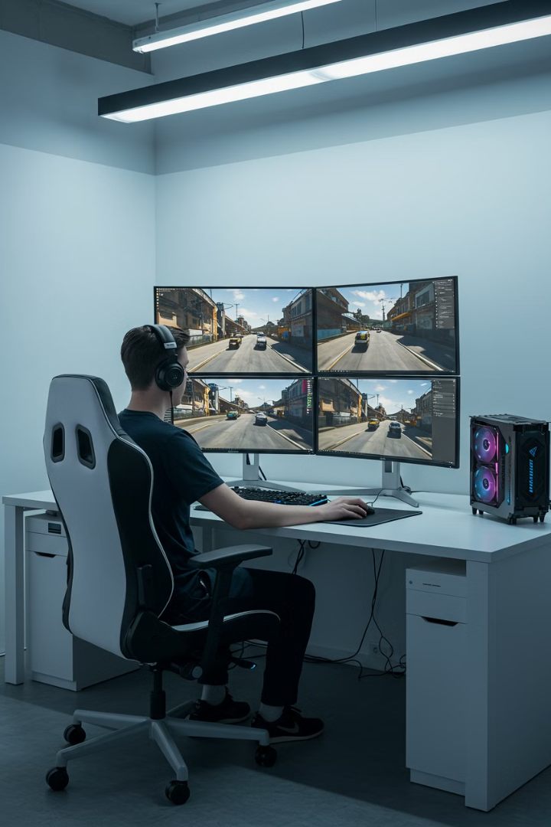



Why is a GPU Important?
Better Graphics
Faster Performance
Supports Multiple Monitors
A good GPU makes games look realistic and smooth.
GPUs speed up tasks that need a lot of calculations, like rendering videos or training AI models.
A GPU can connect to multiple screens at once, which is useful for work or gaming.
It also helps with high-resolution videos and 3D animations.

Slide 6
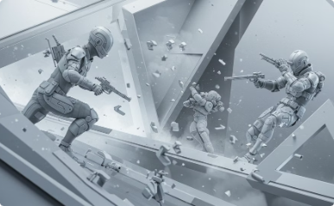
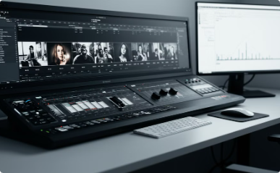

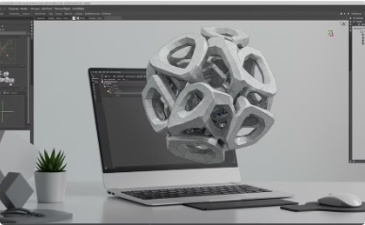
Common Uses of a GPU
Gaming
Video Editing
Machine Learning
Design and Animation
GPUs are essential for modern games, which need to render complex 3D worlds and high-quality textures.
GPUs help edit and render videos faster, especially for 4K or 8K videos.
GPUs are used to train AI models because they can handle thousands of calculations at once.
Programs like Photoshop, Blender, and AutoCAD use GPUs to create and edit images, 3D models, and animations.

Slide 7




Key Features of a GPU
VRAM (Video RAM)
Cores
This is the memory used by the GPU to store textures, images, and other data. More VRAM means better performance for high-resolution tasks.
GPUs have thousands of small cores that work together to process tasks quickly.
1
2
Cooling System
Clock Speed
4
3
GPUs can get very hot, so they often have fans or
liquid cooling to keep them cool.
This is how fast the GPU can process data. A higher clock speed means better performance.

Slide 8
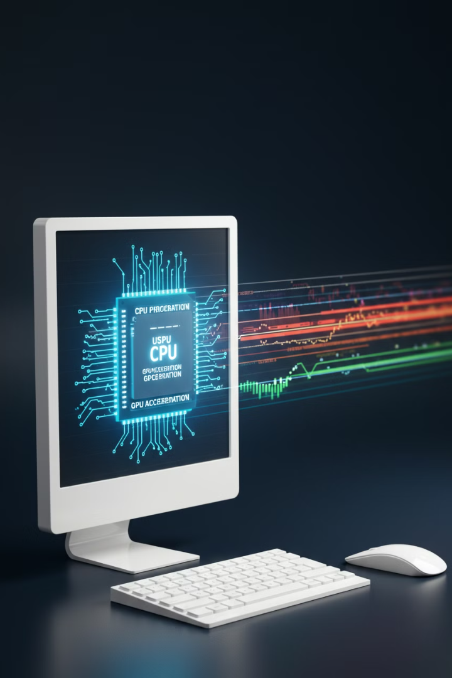
Pros of a GPU
Fast Graphics Processing
GPUs make games and videos look amazing.
Efficient for Parallel Tasks
They can handle many tasks at once, making them great for AI, scientific research, and data analysis.
Improves Overall Performance
A good GPU can make your computer faster for graphics-heavy tasks.

Slide 9
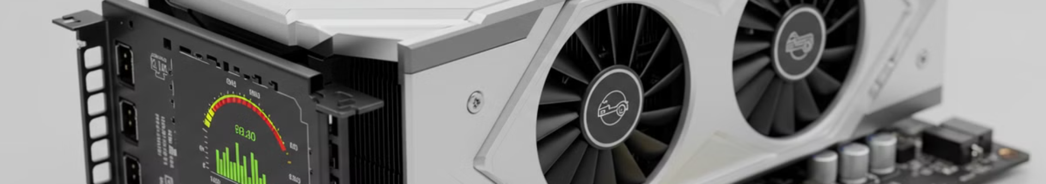
Cons of a GPU
Expensive
1
High-end GPUs can be very costly.
2
Power Consumption
GPUs use a lot of electricity and can make your computer hotter.
Not Needed for Basic Tasks
3
If you only use your computer for browsing or word processing, you don't need a powerful GPU.

Slide 10



Summary
GPU Purpose
1
Special chip for graphics and calculations
Essential Applications
2
Gaming, video editing, AI tasks
Performance Benefits
3
Faster and more capable for visual tasks
A GPU is a special chip that helps your computer handle graphics and heavy calculations. It's essential for gaming, video editing, and AI tasks. While it's not needed for basic computer use, a good GPU can make your computer faster and more capable for visual and complex tasks.

